Slide 1
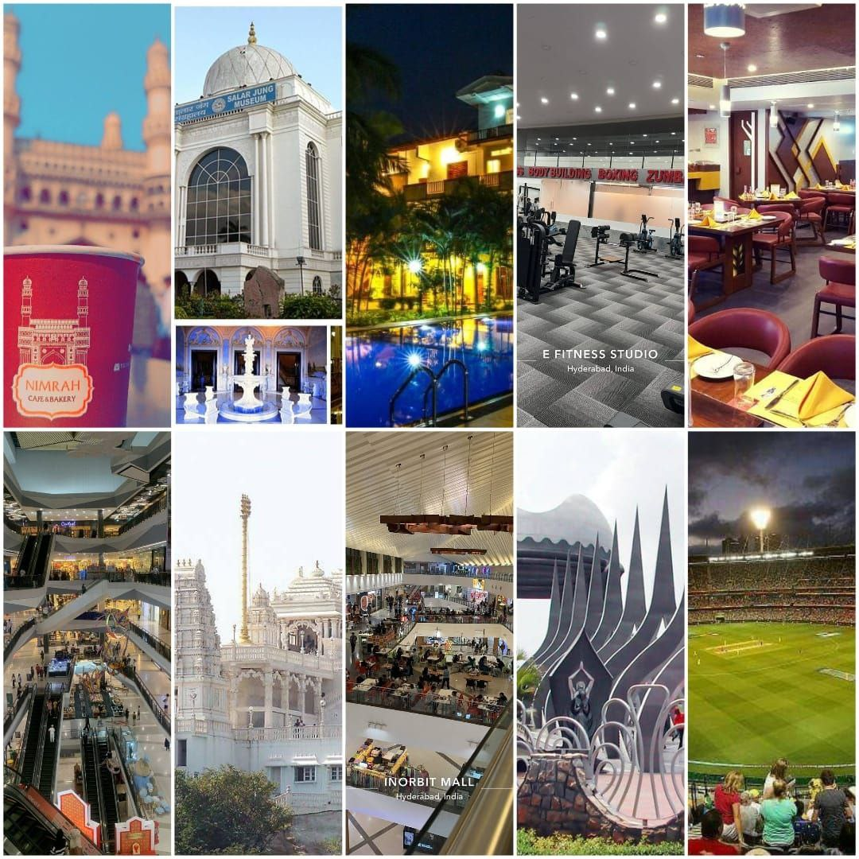
DOMAIN:TOUR &TOURISM GUIDE FOR THE TOURIST

Slide 2

TEAM MEMBERS
2210030068-D.SHAHEEN
2210030352-K.ARCHANA
2210030139-Y.VARSHINI
2210030140-R.SAI PRANATHI
2210030249-S.NEHA REDDY

Slide 3
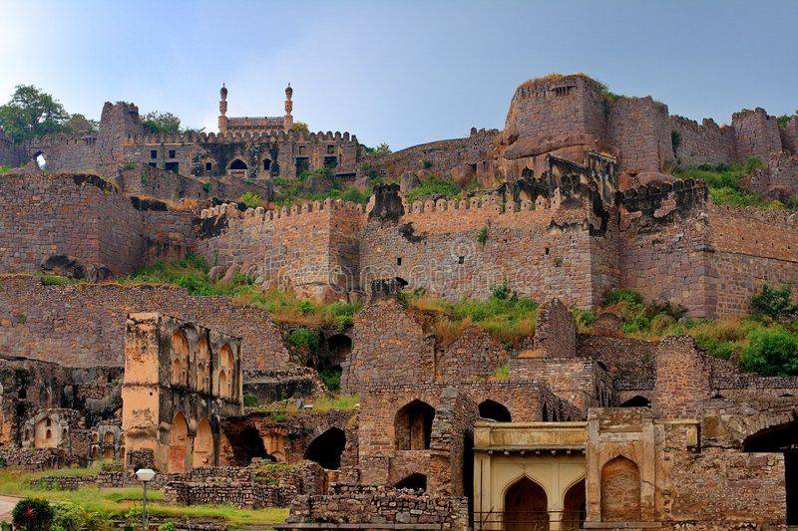
INTRODUCTION TO GUIDE THE TOURSIT
Welcome to our tour and tourism Website. Whether you're a seasoned traveler or planning your very first adventure, this guide is your passport to discovering the world's most captivating destinations. From iconic landmarks to hidden gems and cultural experiences. Join us as we embark on a virtual journey across continents, exploring the best places to visit, activities to indulge in, and tips to make your travel experiences truly unforgettable, we also provide you with the navigation route map for selected places. Get ready to pack your bags and let your wanderlust guide you as we navigate the exciting world of travel together!

Slide 4
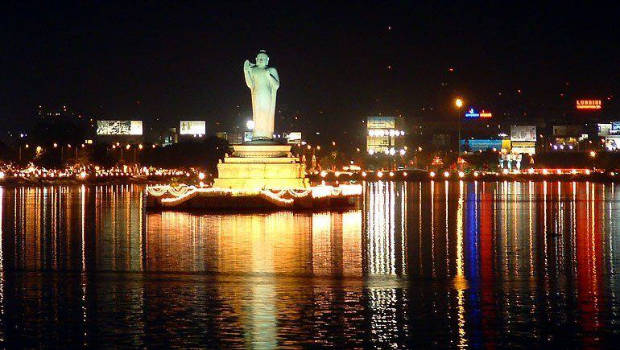
PROBLEM STATEMENT
Many travelers face difficulty in planning their trips efficiently due to the overwhelming amount of information available online. They struggle to find reliable guidance on must-visit landmarks and authentic restaurants while also navigating unfamiliar routes in a new city. This often leads to confusion, wasted time, and missed opportunities to experience the best of what a destination has to offer. Therefore, there is a clear need for a user-friendly tourism guide website that simplifies the process by offering clear recommendations for famous landmarks, popular restaurants, and easy-to-follow route maps, helping travelers make the most of their adventures without the stress and hassle of extensive research and planning.

Slide 5
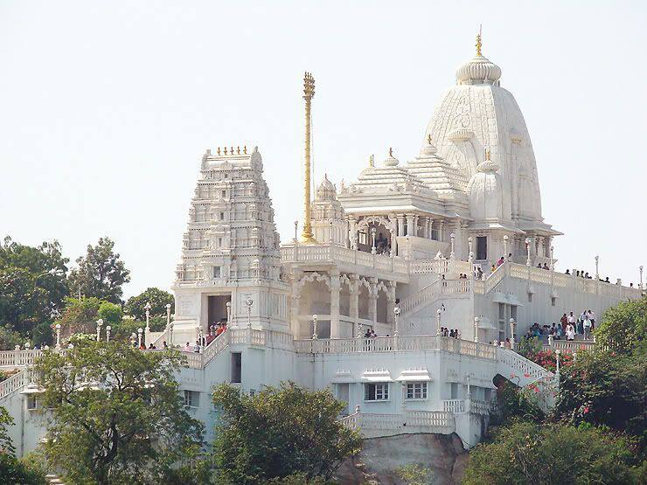
SOLUTION BREAKDOWN
SOLUTION: Our tourism guide website is designed to make travel planning easy and enjoyable for everyone. With just a few clicks, travelers can discover the most famous landmarks and renowned restaurants in any destination, along with detailed route maps to help them get there hassle-free. BENEFITS: Convenience: Travelers can access all the information they need in one place, saving time and effort in researching multiple sources.
Clear Recommendations: Our website provides clear recommendations for must-visit landmarks and top-rated restaurants, making it easy for travelers to prioritize their itinerary.
Easy Navigation: Detailed route maps ensure that travelers can navigate their way to each destination with confidence, even in unfamiliar surroundings.
Authentic Experiences: By highlighting authentic local landmarks and restaurants, we help travelers discover the true essence of a destination, avoiding tourist traps. 5.Customization: Travelers can personalize their experience by filtering landmarks and restaurants based on their interests, budget, and dietary preferences.

Slide 6
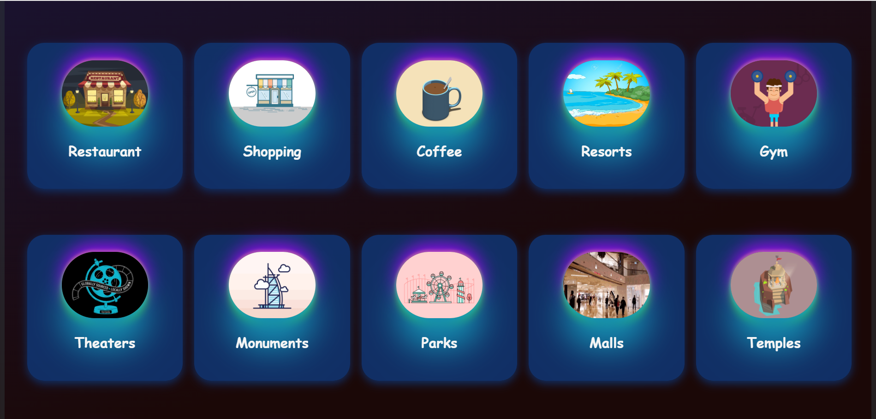
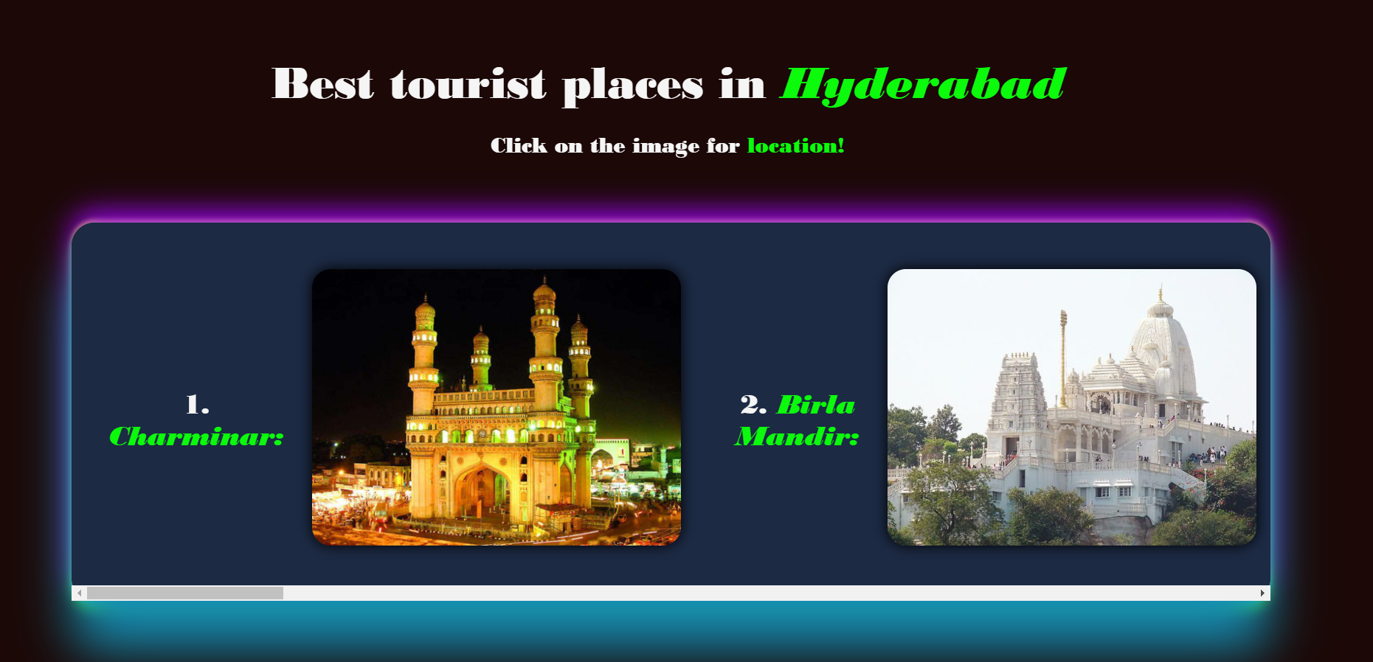

Slide 7
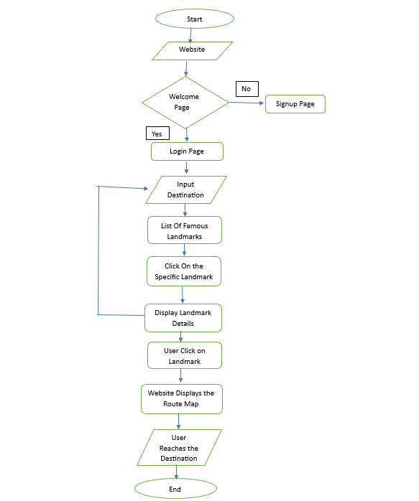
FLOWCHART

Slide 8
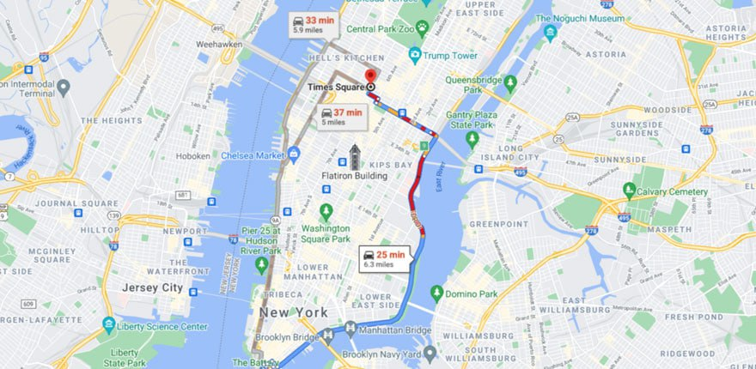
IMPLEMENTATION
Design: Create a user-friendly website layout with easy navigation.
Development: Use HTML, CSS, and JavaScript for front-end, PHP.
Database: Set up a database to store landmark, restaurant, and route map data.
API Integration: Integrate Google Maps API for route maps and Yelp API for restaurant reviews.
Content Creation: Write concise descriptions and gather images for landmarks and restaurants.
Search Functionality: Implement a search feature for users to find specific landmarks and restaurants.
Testing: Test the website for functionality, usability, and responsiveness.
Launch: Deploy the website on a hosting platform and make it accessible to users.
Marketing: Promote the website through social media, travel forums, and partnerships with tourism organizations.

Slide 9
CONCLUSION
In conclusion, our tourism guide website offers travelers a seamless experience to explore famous landmarks, discover renowned restaurants, and navigate route maps with ease. With user-friendly design, comprehensive content, and intuitive functionality, we aim to enhance every traveler's journey, making it memorable and enjoyable. Whether you're planning your next adventure or seeking inspiration for your travels, our website is your ultimate companion to unlock the wonders of the world. Happy exploring!

Slide 10
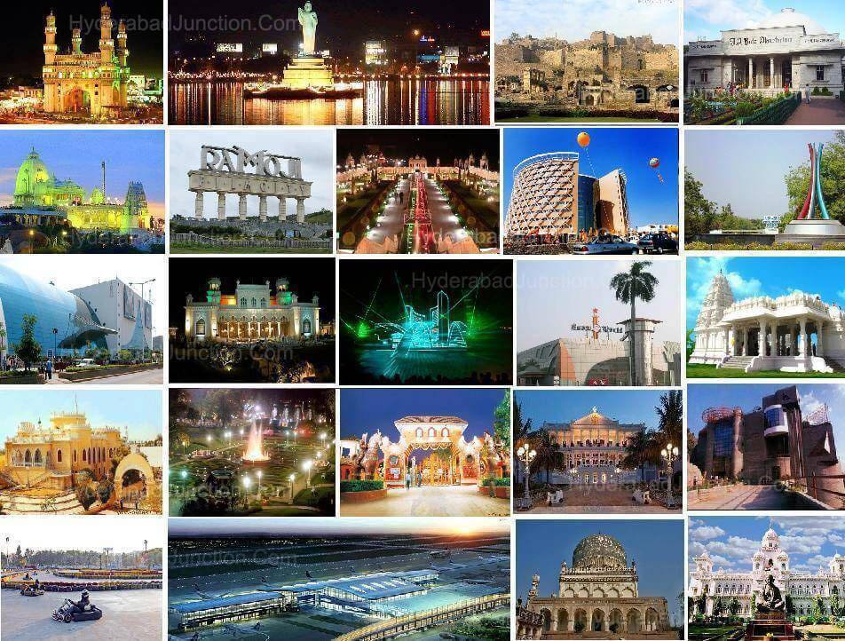
“Travelling – it leaves you speechless, then turns you into a storyteller.”

Slide 11


